Slide 1
Test cases on Login and Registration GUI
Name: Devika Dhumal
Roll No: 19
LP2

Slide 2
index

Slide 3
Problem statement
Aim: Design a simple GUI and run varied Test Cases
Objective:
Write test cases for varied testing
Understand how GUI testing works
Expected Outcome:
Better understanding of Testing methodology

Slide 4
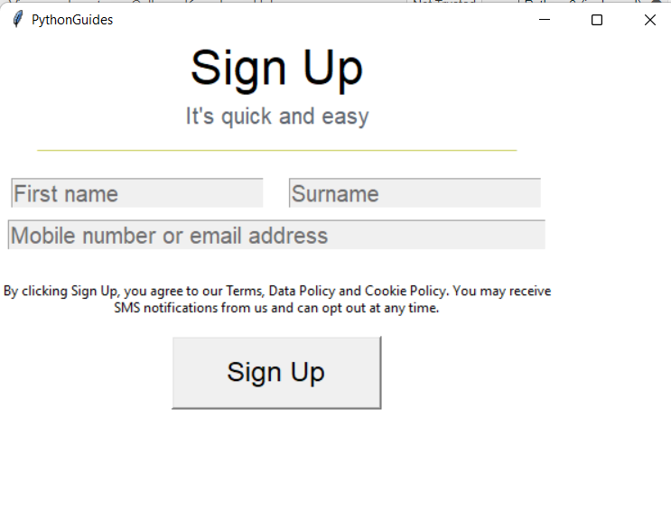
introduction
We have tried creating a sign up page using the python library of tkinter. We will be trying to run different validations that shall work as our test cases. Whenever a test case fails our validations will pop and let us know. It is very important to understand how test cases and testing helps our application be more deployment ready and makes it user friendly.

Slide 5
Functionality test cases
Verify that the registration page has all the fields as per requirement.
Verify that the user able to signup or register by entering the valid data in all the fields
Verify that the registration form by entering the data only in the non-mandatory field.
Verify the registration page without entering any data in fields.
Verify that the alert message for all mandatory fields.
Verify the confirmation message when the user successfully signup
Verify that all fields have a valid label and place holder.
Verify that the user was able to signup by entering the valid data only in mandatory fields.
Ensure that the error message is displayed when the user enters the valid username and invalid Password in the login credential.

Slide 6
Functionality test cases
Verify that the registration page has all the fields as per requirement.
Verify that the user able to signup or register by entering the valid data in all the fields
Verify that the registration form by entering the data only in the non-mandatory field.
Verify the registration page without entering any data in fields.
Verify that the alert message for all mandatory fields.
Verify the confirmation message when the user successfully signup
Verify that all fields have a valid label and place holder.
Verify that the user was able to signup by entering the valid data only in mandatory fields.
Ensure that the error message is displayed when the user enters the valid username and invalid Password in the login credential.

Slide 7
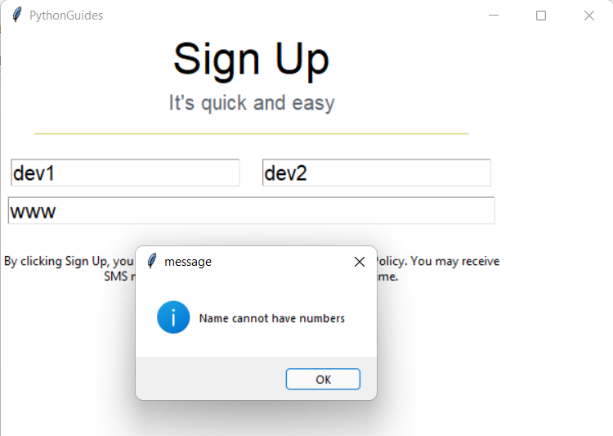
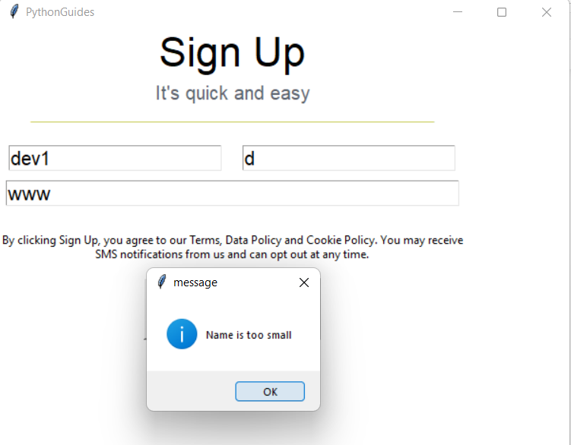
Execution and validation of test cases
First name and Surname should not have alpha numeric values.
First name and surname should not have less than 3 character strings as their inputs

Slide 8
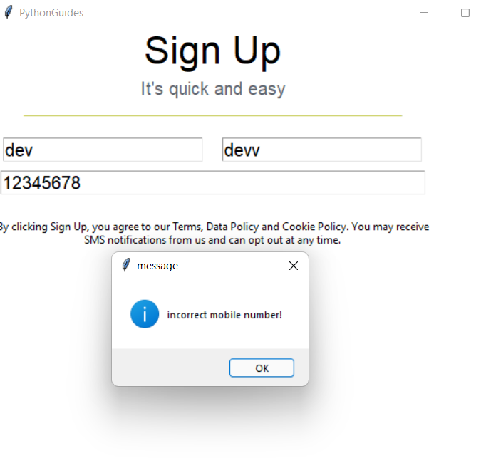
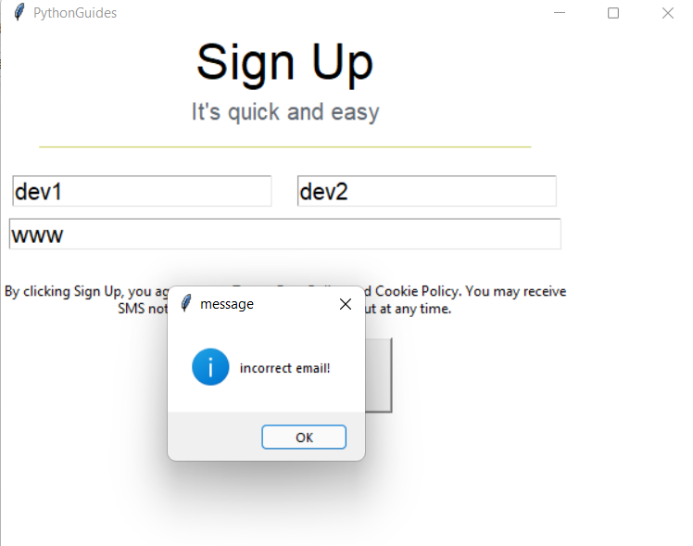
Execution and validation of test cases
Mobile number should have 10 valid digits
Email id should not have any special characters other than ‘@’, ‘.’

Slide 9
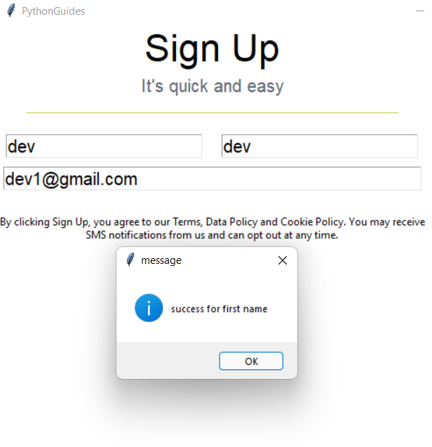

Execution and validation of test cases
The correct and valid input should give the success message to let the user know they can now proceed.

Slide 10
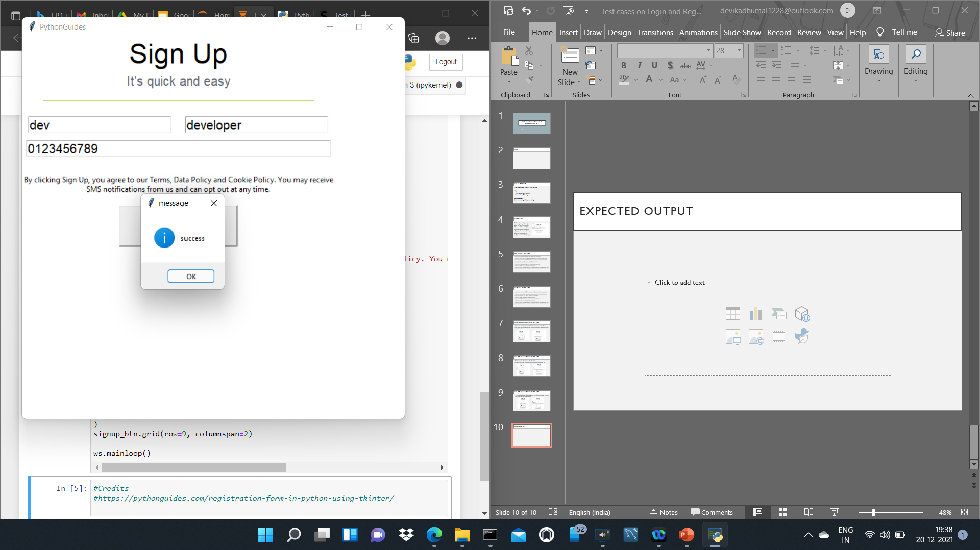
Expected Output
Hence we have executed and validated different test cases on our GUI application.

